Slide 1
Balance Your Thinking
Notes:
Balance Your Thinking: (45-50 minutes)
Background and Overview of Cognitive Traps (2-3 minutes)
Discussion of Cognitive Traps (15 minutes)
Balance Your Thinking Strategies (5 minutes)
Balance Your Thinking Activity and Facilitated Debrief (15-20 minutes)
Review, Questions and Wrap-up: (5 minutes)

Slide 2
How does Balance Your Thinking help you?
Helps you see situations accurately and take action based on evidence.
Helps you respond in ways that align with your values and support your goals
Ultimately, helps us improve performance because we are reacting to facts and evidence.
Notes:
Instructions to Participants:
Balance Your Thinking is a skill that builds on ReFrame. Sometimes it might be enough for us to examine the connections between our thoughts and reactions, but other times we may need to ask more questions to ensure our thoughts are accurate.
Balance Your Thinking is a skill to ensure you perceive situations accurately, and help you react productively.
The skill also helps you respond in ways that align with your values and support your goals
Think of this skill as a way to look at a situation like a person on the outside looking in, seeing everything and evaluating based on evidence and facts, not a gut feeling or reactions.

Slide 3
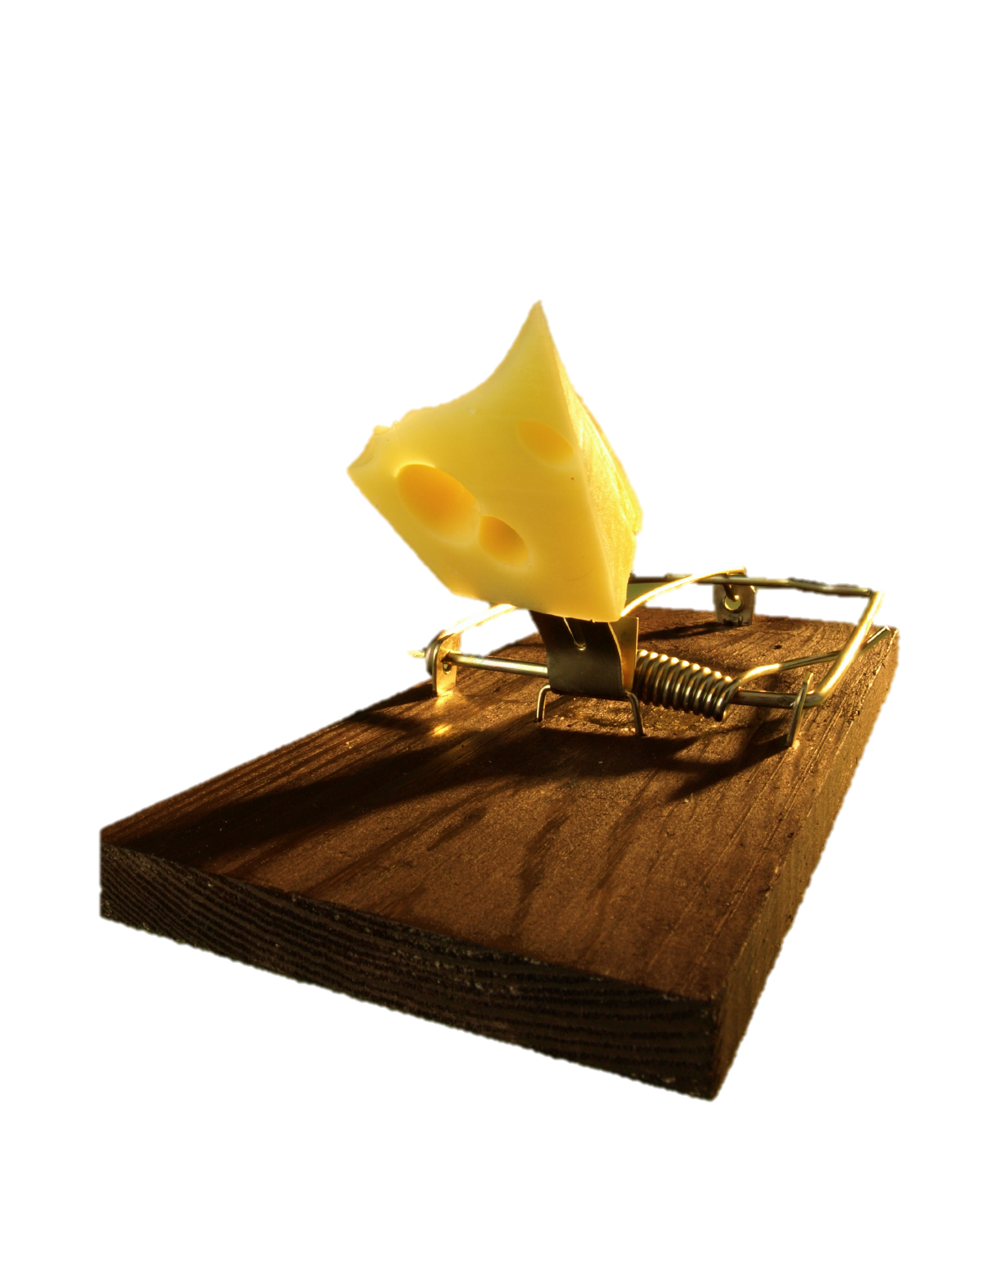
Cognitive Traps
Cognitive traps interfere with accuracy
They often involve jumping to conclusions
We all get stuck in them!
Beck, Seligman
Notes:
Instructions to Participants:
Our beliefs and thoughts can interfere with our ability to accurately assess a situation.
Sometimes we don’t fully consider all the evidence and we make inaccurate judgments about an event. We can focus on the wrong information, miss something valuable, or make assumptions.
The goal of Balance Your Thinking is to help you avoid these cognitive traps so that you can perceive situations accurately.
We’ll talk about a few cognitive traps that many people can relate to, but generally, these are just examples. The main goal of this skill is to make sure you can get out of the trap.

Slide 4
For example…
Notes:
Video:
Cat and Dinner
Here is a situation where it might be easy to assume you know what is going on.
http://www.youtube.com/watch?v=MmiwbRXIWvs

Slide 5
Examples of Common Cognitive Traps
All-or-nothing
Confirmation bias
Blaming others/Blaming yourself
Mind reading
Beck, 1995
Notes:
Instructions to Participants:
There are many different cognitive traps, but generally they are all a form of reacting when you don’t have all the information you need, or you aren’t fully considering everything. We will discuss each of these cognitive traps in greater detail, but this isn’t an exhaustive list, and they aren’t mutually exclusive. You can also be stuck in multiple traps at the same time.
Note to Trainer:
If you have time and would like more discussion, you could ask participants how each cognitive trap interferes with performance.
You do not need to provide a personal example for each of the traps—the key piece of this skill is the understanding of the strategies to get out of the traps. It is not essential that participants identify whether or not they are in a specific trap.

Slide 6
All-or-Nothing
Looking at things in extreme ways
  Example: “Nothing ever works out for me”
  Everything…always…never
Beck, 1995
Notes:
Instructions to Participants:
One of the most common cognitive traps is all-or-nothing. All-or-nothing thoughts are characterized by absolute terms like always, never, and forever. It can also be thinking of something as only good or bad, perfect or terrible. Getting stuck in this cognitive trap can contribute to a sense of hopelessness. For example, ‘you ALWAYS leave the lights on” or ‘you NEVER remember your keys.’
Few things are ever absolute, and there are generally grey areas. When we are stuck in this trap, we forget those grey areas.

Slide 7
Confirmation Bias
We are attracted to information that supports what we already believe and ignore evidence that doesn’t fit
Beck, 1995
Notes:
Instructions to Participants:
Confirmation bias is when we only find information that supports our existing opinion. We are attracted to information that confirms what we already believe. We search for or interpret information in a way that confirms our existing beliefs and thoughts. For example, if you believe that a co-worker is difficult to work with, you may only see him or her doing things that confirm that opinion—like being late or making a mistake. If you have a confirmation bias, you miss the positive things that co-worker may do, such as stay late to work on something, or help someone else.

Slide 8
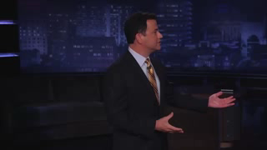
Example: Confirmation Bias
Notes:
Instructions to Participants:
Here is a good example of a confirmation bias. Jimmy Kimmel gives people on the street an iPhone 4S, but tells them it is an iPhone 5. They believe that the iPhone 5 is better than the old version, and find evidence to support this belief. This video is a little outdated now that they’ve released the iPhone X, but it still gives you a good sense of how people will search for information that confirms what they already think.
Video:
Jimmy Kimmel
http://www.youtube.com/watch?feature=player_embedded&v=rdIWKytq_q4

Slide 9
Blaming Others and Blaming Yourself
Blaming others: Only focus on other people as the cause of events
  “I went to bed late because my roommate kept me up watching movies”
Blaming Yourself: Ignoring the contributions of others
  “I missed the final free throw so it is my fault the team lost the game”
Beck, 1995
Notes:
Instructions to Participants:
Blaming others is when we focus only on other people as the source of your feelings or the cause of events. For example, “I couldn’t get to sleep early because my roommate kept me up watching movies.”
Blaming yourself is when we only think about yourself in a situation, and not seeing the contributions of others. For example, your supervisor is very quiet, and you assume he or she is upset about your performance. Instead, it may be that he or she may be thinking of something unrelated.

Slide 10
Mind reading
Two forms:
  Assuming you know what the other person is thinking, or
  Expecting another person to know what you are thinking
Beck, 1995
Notes:
Instructions to Participants:
“Mind reading” is something we’re all guilty of at some time or another. It can come in two different forms:
Assuming you know what the other person is thinking, or
Expecting another person to know what you are thinking.

Slide 11
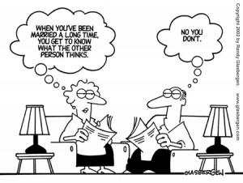
Notes:
Instructions to Participants:
One of the most common places this happens is in close relationships…
After so much time together, you start to assume you know what your best friend or spouse is thinking, and may expect him/her to know what you’re thinking.

Slide 12
Balance Your Thinking
If you are stuck in a trap, there are three ways to Balance Your Thinking:
  Examine the evidence
  Check for a Double-standard
  Phone-a-friend or ASK
Notes:
Instructions to Participants:
Ultimately, this skill is about helping you take action based on evidence. So the skill is about understanding if you may be in a cognitive trap, and then using a strategy to get out of that trap. And, it helps you respond to events in ways that align with your values. You can’t do that well if you don’t have all the evidence and are stuck in a cognitive trap.
So, first, you know how to use reframe to understand how your thoughts drive your reactions. If your reaction isn’t helpful, think about whether you may be jumping to conclusions and in a cognitive trap. If so, you can use three strategies to Balance Your Thinking.
There are three strategies for balancing your thinking. We’ll discuss each of these strategies.

Slide 13
Strategy: Examine the Evidence
Examine the evidence:
  Is there any evidence to support this thought?
  Is there any evidence to challenge this thought?
  Am I missing any information?
Notes:
Instructions to Participants:
So how can we avoid these cognitive traps? When you find yourself using unbalanced thinking, you can try three strategies to get out of it:
Let’s start by examining the evidence. Do you know everything you need to know? Is there any evidence to support what you think? Is there any evidence to challenge what you think? Am I missing information that would help me react more productively?
Note to Trainer:
Depending on timing, as you move through the strategies, you can ask participants to identify their own examples for each strategy.

Slide 14
Strategy: Check for a Double-Standard
  Check for a double-standard:
  Would I judge other people as harshly if they did the same thing?
  Am I judging myself more harshly than I would judge someone else?
Notes:
Instructions to Participants:
For the second strategy, Check for a double-standard:
Would I judge other people harshly if they did the same thing?
Am I judging myself more harshly than I would judge someone else?
For example: You missed a foul shot and blame yourself for losing the game. If a team mate missed a foul shot, would you blame him/her for the entire loss?

Slide 15
Strategy: Phone a Friend or Ask
  Phone a friend or ask:
  - Find out if someone unbiased agrees with your thoughts
  - Ask the person(s) involved
Notes:
Instructions to Participants:
The third strategy is to get a second opinion--you can always phone a friend. Make sure you as, an unbiased friend who will be able to see the situation objectively. Find out if someone you trust agrees with your thoughts.
Or ask the people involved so you can be more accurate about the situation.

Slide 16
Balance Your Thinking

Slide 17
Activity: Balance Your Thinking
Step 1: Select an event you feel you didn’t handle well
Step 2: Record your thoughts and reactions
Step 3: Select a thought that resulted in an unhelpful reaction. Then, Balance Your Thinking:
    Examine the evidence
    Check for a Double-standard
    Phone a friend/ask
    Step 4: Do you need to ReFrame your thoughts based on the new evidence? What might you do differently next time?
Notes:
Instructions to Participants:
In your Participant Guide, there is an activity to help you apply Balance Your Thinking to an event in your own life.
Step 1. Start out by selecting an event you feel you didn’t handle well.
Step 2. Record your thoughts and your reactions to those thoughts.
Step 3. Select a thought that resulted in an unhelpful reaction, or maybe in hindsight you wished you hadn’t reacted based on. Check for unbalanced thinking by examining the evidence, checking for a double standard, phoning a friend for information and/or perspective, or asking the individual involved.
Step 4. Once you have looked at the bigger picture, determine if you need to revise or ReFrame what you thought based on new evidence. Don’t skip this step- it’s the most important part

Slide 18
Debrief
What was helpful?
What was challenging?
How will you use this skill in the future?
Notes:
Facilitated Discussion
What about this activity was helpful?
What was challenging?
How will you use this skill in the future?
Notes to Trainer:
Have some specific examples tailored for your audience ready to discuss with the participants. Refer to the MRT example guide for additional examples.
18

Slide 19

Taco Party

Slide 20
Review: Balance Your Thinking
Balance Your Thinking helps you perceive situations accurately and take action based on evidence
Determine if you are in a cognitive trap
Use the three strategies to Balance Your Thinking
    Examine the evidence
    Check for a double standard
    Phone a Friend or ask
Revise your interpretation of the event if needed

Slide 21


